Slide 1
ENERGY AUDIT FOR HOUSEHOLDS
BY
‘THE CURIOUS FOUR’

Slide 2
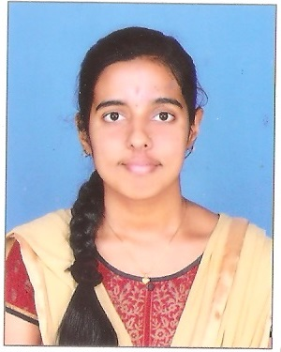



NO OF MEMBERS : 4
K.SAMATHMIKA
J.VISHVAJA
V.SHANMUGA LAKSHMI
NANDINISREE.V.S

Slide 3
CONTRIBUTION OF TEAM MEMBERS
V.SHANMUGA LAKSHMI-Research on energy audit,Machine learning K.SAMATHMIKA-Machine learning ,webapplication design J.VISHVAJA-Machine learning,Data collection NANDINISREE.V.S -Research on energy audit,documentaion

Slide 4
TECHNOLOGIES AND PROGRAMMING LANGUAGES USED
Spyder
Xampp
Machine learning
PHP
HTML
PYTHON

Slide 5
ARCHITECTURAL FLOW
Data collection
Data set formation
Analysing the data
Grouping the user into categories
Predicting seasonal usage
Graphical representation of energy
Suggestions to reduce energy loss

Slide 6
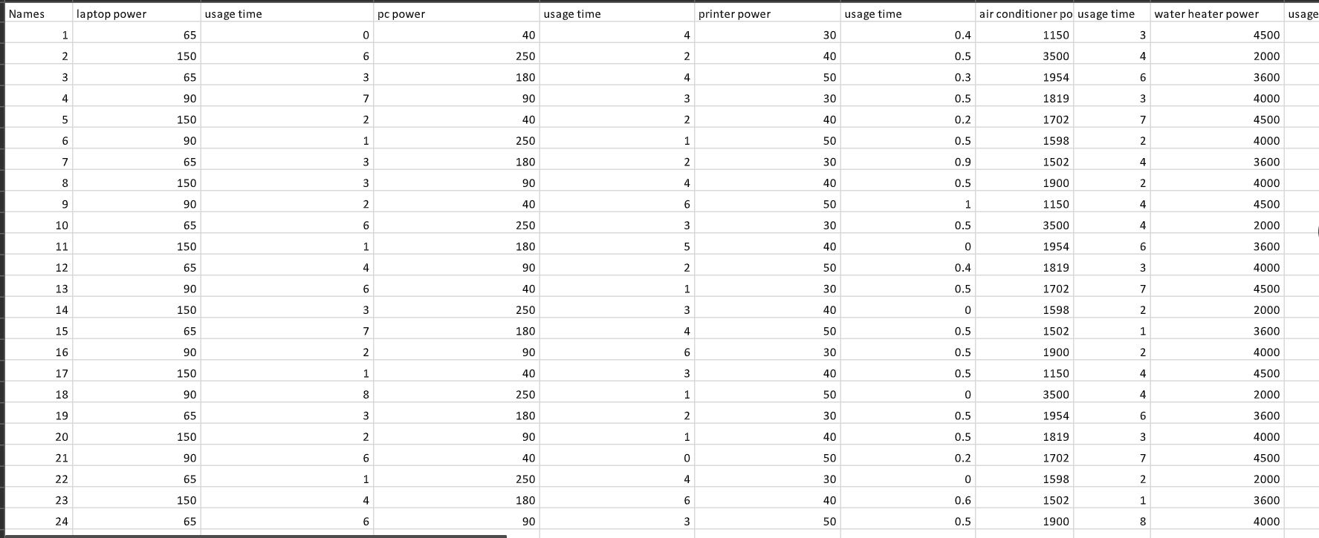
DATA

Slide 7
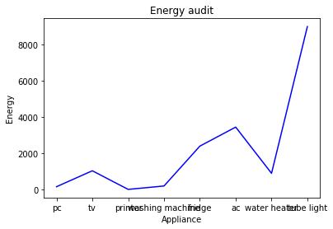
ANALYZED DATA

Slide 8
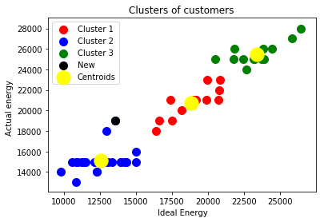
GROUPING OF USERS

Slide 9
SEASONAL ANALYSIS
Seasons , festivals and family functions play a major role in the increased amount of a Residential Electricity Bill.
Being aware of the position in which a household fits into , regarding these criterions is vital.
Designing a model that predicts the level of a particular household on these occasions can prove to be highly desirable.
Therefore an analysis is done based on the user inputs in order to help a user know their level in terms of energy loss.

Slide 10
OUTCOMES OF SEASONAL ANALYSIS
A prediction of a very high energy loss by the machine learning model makes the people of that particular household prone to high EB bills.
A prediction that contradicts the above point makes the people of the household relieved of the tensions of a high EB bill.

Slide 11
SIGNIFICANCE OF THE PROJECT
The main motive and objective of this project is to make people understand the importance of electrical energy which is maybe available for now but not assured to be abundantly available in the future.

Slide 12


Slide 13
THANK YOU

